Slide 1
El problema del
Bandido Multi Brazo

Slide 2
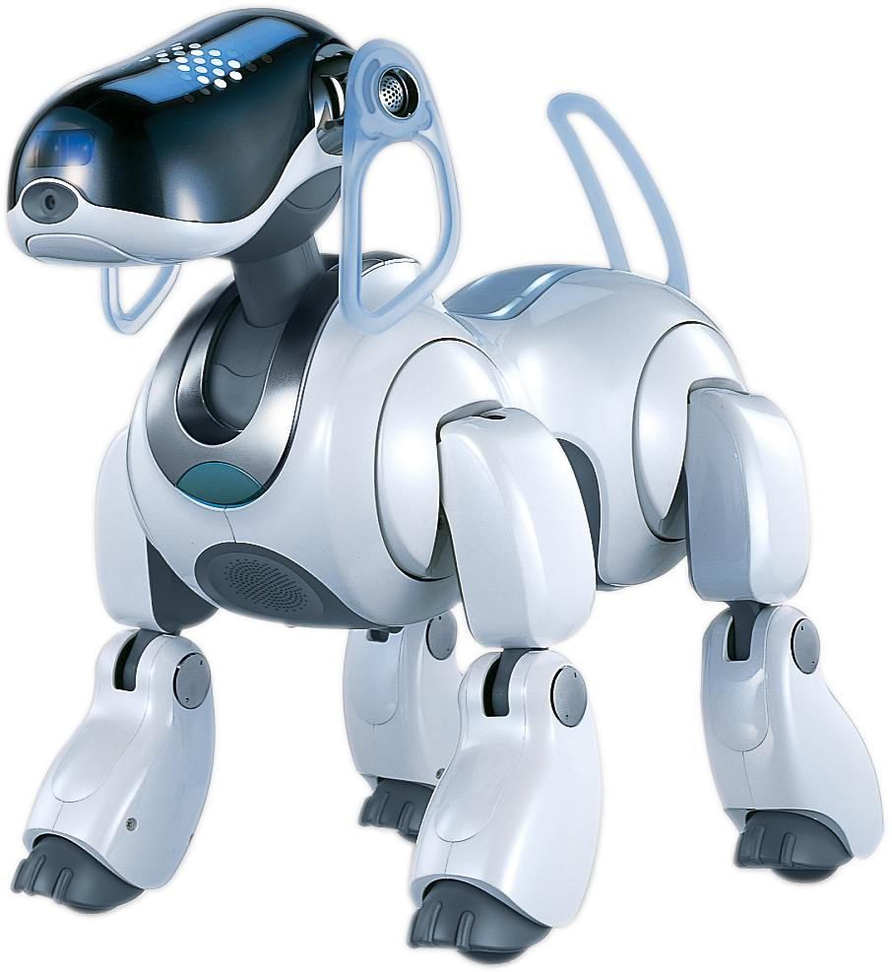

Slide 3
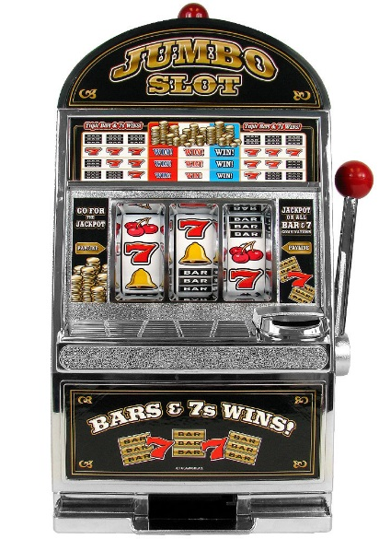
El problema del Bandido Multi Brazo
D1
D2
D3
D4
D5
Notes:
For the random bandit problem it is assumed that in each trial the rewards xi (t) are drawn independently from some fixed but unknown distributions D 1 ; : : : ; D K

Slide 4
El problema del Bandido Multi Brazo
D1
D2
D3
D4
D5
Notes:
For the random bandit problem it is assumed that in each trial the rewards xi (t) are drawn independently from some fixed but unknown distributions D 1 ; : : : ; D K
------- The expected total reward of a learning algorithm should be close to the expected total reward given by the best distribution D I
-------
Explotation vs Exploration
Thus the regret of a learning algorithm is suffered when alternative which is not optimal.
-----
Using Conﬁdence Bounds for
Exploitation-Exploration Trade-oﬀs

Slide 5





El problema del Bandido Multi Brazo
D1
D2
D3
D4
D5
Examples used for educational purposes. No affiliation with Coca-Cola
Notes:
v.s. A/B test
A/B test = pure exploration
For the random bandit problem it is assumed that in each trial the rewards xi (t) are drawn independently from some fixed but unknown distributions D 1 ; : : : ; D K

Slide 6
Idea de Upper Confidence Bound (UCB)

Slide 7
El problema del Bandido Multi Brazo
D1
D2
D3
D4
D5
Notes:
For the random bandit problem it is assumed that in each trial the rewards xi (t) are drawn independently from some fixed but unknown distributions D 1 ; : : : ; D K

Slide 8



El problema del Bandido Multi Brazo
Tenemos d brazos. Por ejemplo, los brazos son anuncios que mostramos a los usuarios cuando se conectan a una página web.
Cada vez que un usuario se conecta a la página web, se desencadena una ronda.
En cada ronda, n, se elige uno de los anuncios a ser mostrado al usuario.
A cada ronda n, el anuncio i da una recompensa:
Si el usuario hace click en el anuncio i en la ronda n
Si el usuario no hace click en el anuncio i en la ronda n
Nuestra meta es maximizar la recompensa a través de las rondas que se lleven a cabo.

Slide 9



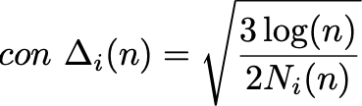
Algoritmo Upper Confidence Bound
PASO 1: A cada ronda n, se consideran dos números para cada i
El número de veces que el anuncio i se selecciona hasta la ronda n,
La suma de las recompensas del anuncio i hasta la ronda n
PASO 2: A partir de estos dos números calculamos
La recompensa media del anuncio i hasta la ronda n
El intervalo de confianza en la ronda n:
PASO 3: Se selecciona el anuncio i con mayor límite superior del intervalo de confianza (UCB):

Slide 10
Algoritmo Upper Confidence Bound
D1
D2
D3
D4
D5
Notes:
For the random bandit problem it is assumed that in each trial the rewards xi (t) are drawn independently from some fixed but unknown distributions D 1 ; : : : ; D K

Slide 11
Algoritmo Upper Confidence Bound
D1
D2
D3
D4
D5
Notes:
For the random bandit problem it is assumed that in each trial the rewards xi (t) are drawn independently from some fixed but unknown distributions D 1 ; : : : ; D K
------- The expected total reward of a learning algorithm should be close to the expected total reward given by the best distribution D I
-------
Explotation vs Exploration
Thus the regret of a learning algorithm

Slide 12
Algoritmo Upper Confidence Bound
D1
D2
D3
D4
D5
Notes:
For the random bandit problem it is assumed that in each trial the rewards xi (t) are drawn independently from some fixed but unknown distributions D 1 ; : : : ; D K

Slide 13
Algoritmo Upper Confidence Bound
D1
D2
D3
D4
D5
Notes:
For the random bandit problem it is assumed that in each trial the rewards xi (t) are drawn independently from some fixed but unknown distributions D 1 ; : : : ; D K

Slide 14
Algoritmo Upper Confidence Bound
D1
D2
D3
D4
D5
Notes:
For the random bandit problem it is assumed that in each trial the rewards xi (t) are drawn independently from some fixed but unknown distributions D 1 ; : : : ; D K

Slide 15
Algoritmo Upper Confidence Bound
D1
D2
D3
D4
D5
Notes:
For the random bandit problem it is assumed that in each trial the rewards xi (t) are drawn independently from some fixed but unknown distributions D 1 ; : : : ; D K

Slide 16
Algoritmo Upper Confidence Bound
D1
D2
D3
D4
D5
Notes:
For the random bandit problem it is assumed that in each trial the rewards xi (t) are drawn independently from some fixed but unknown distributions D 1 ; : : : ; D K

Slide 17
Algoritmo Upper Confidence Bound
D1
D2
D3
D4
D5
Notes:
For the random bandit problem it is assumed that in each trial the rewards xi (t) are drawn independently from some fixed but unknown distributions D 1 ; : : : ; D K

Slide 18
Algoritmo Upper Confidence Bound
D1
D2
D3
D4
D5
Notes:
For the random bandit problem it is assumed that in each trial the rewards xi (t) are drawn independently from some fixed but unknown distributions D 1 ; : : : ; D K

Slide 19
Algoritmo Upper Confidence Bound
D1
D2
D3
D4
D5
Notes:
For the random bandit problem it is assumed that in each trial the rewards xi (t) are drawn independently from some fixed but unknown distributions D 1 ; : : : ; D K

Slide 20
Algoritmo Upper Confidence Bound
D1
D2
D3
D4
D5
Notes:
For the random bandit problem it is assumed that in each trial the rewards xi (t) are drawn independently from some fixed but unknown distributions D 1 ; : : : ; D K

Slide 21
Algoritmo Upper Confidence Bound
D1
D2
D3
D4
D5
Notes:
For the random bandit problem it is assumed that in each trial the rewards xi (t) are drawn independently from some fixed but unknown distributions D 1 ; : : : ; D K

Slide 22
Algoritmo Upper Confidence Bound
D1
D2
D3
D4
D5
Notes:
For the random bandit problem it is assumed that in each trial the rewards xi (t) are drawn independently from some fixed but unknown distributions D 1 ; : : : ; D K

Slide 23
Algoritmo Upper Confidence Bound
D1
D2
D3
D4
D5
Notes:
For the random bandit problem it is assumed that in each trial the rewards xi (t) are drawn independently from some fixed but unknown distributions D 1 ; : : : ; D K

Slide 24
Algoritmo Upper Confidence Bound
D1
D2
D3
D4
D5
Notes:
For the random bandit problem it is assumed that in each trial the rewards xi (t) are drawn independently from some fixed but unknown distributions D 1 ; : : : ; D K

Slide 25
Algoritmo Upper Confidence Bound
D1
D2
D3
D4
D5
Notes:
For the random bandit problem it is assumed that in each trial the rewards xi (t) are drawn independently from some fixed but unknown distributions D 1 ; : : : ; D K

Slide 26
Algoritmo Upper Confidence Bound
D1
D2
D3
D4
D5
Notes:
For the random bandit problem it is assumed that in each trial the rewards xi (t) are drawn independently from some fixed but unknown distributions D 1 ; : : : ; D K

Slide 27
Algoritmo Upper Confidence Bound
D1
D2
D3
D4
D5
Notes:
For the random bandit problem it is assumed that in each trial the rewards xi (t) are drawn independently from some fixed but unknown distributions D 1 ; : : : ; D K

Slide 28
Algoritmo Upper Confidence Bound
D1
D2
D3
D4
D5
Notes:
For the random bandit problem it is assumed that in each trial the rewards xi (t) are drawn independently from some fixed but unknown distributions D 1 ; : : : ; D K

Slide 29
Algoritmo Upper Confidence Bound
D1
D2
D3
D4
D5
Notes:
For the random bandit problem it is assumed that in each trial the rewards xi (t) are drawn independently from some fixed but unknown distributions D 1 ; : : : ; D K

Slide 30
Algoritmo Upper Confidence Bound
D1
D2
D3
D4
D5
Notes:
For the random bandit problem it is assumed that in each trial the rewards xi (t) are drawn independently from some fixed but unknown distributions D 1 ; : : : ; D K

Slide 31
Algoritmo Upper Confidence Bound
D1
D2
D3
D4
D5
Notes:
For the random bandit problem it is assumed that in each trial the rewards xi (t) are drawn independently from some fixed but unknown distributions D 1 ; : : : ; D K

Slide 32
Algoritmo Upper Confidence Bound
D1
D2
D3
D4
D5
Notes:
For the random bandit problem it is assumed that in each trial the rewards xi (t) are drawn independently from some fixed but unknown distributions D 1 ; : : : ; D K

Slide 33
Algoritmo Upper Confidence Bound
D1
D2
D3
D4
D5
Notes:
For the random bandit problem it is assumed that in each trial the rewards xi (t) are drawn independently from some fixed but unknown distributions D 1 ; : : : ; D K

Slide 34
Algoritmo Upper Confidence Bound
D1
D2
D3
D4
D5
Notes:
For the random bandit problem it is assumed that in each trial the rewards xi (t) are drawn independently from some fixed but unknown distributions D 1 ; : : : ; D K

Slide 35
Algoritmo Upper Confidence Bound
D1
D2
D3
D4
D5
Notes:
For the random bandit problem it is assumed that in each trial the rewards xi (t) are drawn independently from some fixed but unknown distributions D 1 ; : : : ; D K

Slide 36
Algoritmo Upper Confidence Bound
D1
D2
D3
D4
D5
Notes:
For the random bandit problem it is assumed that in each trial the rewards xi (t) are drawn independently from some fixed but unknown distributions D 1 ; : : : ; D K

Slide 37
Algoritmo Upper Confidence Bound
D1
D2
D3
D4
D5
Notes:
For the random bandit problem it is assumed that in each trial the rewards xi (t) are drawn independently from some fixed but unknown distributions D 1 ; : : : ; D K

Slide 38
Algoritmo Upper Confidence Bound
D1
D2
D3
D4
D5
Notes:
For the random bandit problem it is assumed that in each trial the rewards xi (t) are drawn independently from some fixed but unknown distributions D 1 ; : : : ; D K

Slide 39
Algoritmo Upper Confidence Bound
D1
D2
D3
D4
D5
Notes:
For the random bandit problem it is assumed that in each trial the rewards xi (t) are drawn independently from some fixed but unknown distributions D 1 ; : : : ; D K

Slide 40
Algoritmo Upper Confidence Bound
D1
D2
D3
D4
D5
Notes:
For the random bandit problem it is assumed that in each trial the rewards xi (t) are drawn independently from some fixed but unknown distributions D 1 ; : : : ; D K

Slide 41
Algoritmo Upper Confidence Bound
D1
D2
D3
D4
D5
Notes:
For the random bandit problem it is assumed that in each trial the rewards xi (t) are drawn independently from some fixed but unknown distributions D 1 ; : : : ; D K

Slide 42
Algoritmo Upper Confidence Bound
D1
D2
D3
D4
D5
Notes:
For the random bandit problem it is assumed that in each trial the rewards xi (t) are drawn independently from some fixed but unknown distributions D 1 ; : : : ; D K

Slide 43
Algoritmo Upper Confidence Bound
D1
D2
D3
D4
D5
Notes:
For the random bandit problem it is assumed that in each trial the rewards xi (t) are drawn independently from some fixed but unknown distributions D 1 ; : : : ; D K

Slide 44
Algoritmo Upper Confidence Bound
D1
D2
D3
D4
D5
Notes:
For the random bandit problem it is assumed that in each trial the rewards xi (t) are drawn independently from some fixed but unknown distributions D 1 ; : : : ; D K

Slide 45
Algoritmo Upper Confidence Bound
D1
D2
D3
D4
D5
Notes:
For the random bandit problem it is assumed that in each trial the rewards xi (t) are drawn independently from some fixed but unknown distributions D 1 ; : : : ; D K

Slide 46
Algoritmo Upper Confidence Bound
D1
D2
D3
D4
D5
Notes:
For the random bandit problem it is assumed that in each trial the rewards xi (t) are drawn independently from some fixed but unknown distributions D 1 ; : : : ; D K

Slide 47
Algoritmo Upper Confidence Bound
D1
D2
D3
D4
D5
Notes:
For the random bandit problem it is assumed that in each trial the rewards xi (t) are drawn independently from some fixed but unknown distributions D 1 ; : : : ; D K

Slide 48
Algoritmo Upper Confidence Bound
D1
D2
D3
D4
D5
Notes:
For the random bandit problem it is assumed that in each trial the rewards xi (t) are drawn independently from some fixed but unknown distributions D 1 ; : : : ; D K

Slide 49
Algoritmo Upper Confidence Bound
D1
D2
D3
D4
D5
Notes:
For the random bandit problem it is assumed that in each trial the rewards xi (t) are drawn independently from some fixed but unknown distributions D 1 ; : : : ; D K

Slide 50
Algoritmo Upper Confidence Bound
D1
D2
D3
D4
D5
Notes:
For the random bandit problem it is assumed that in each trial the rewards xi (t) are drawn independently from some fixed but unknown distributions D 1 ; : : : ; D K

Slide 51

Machine Learning A-Z
Notes:
For the random bandit problem it is assumed that in each trial the rewards xi (t) are drawn independently from some fixed but unknown distributions D 1 ; : : : ; D K

